Slide 1
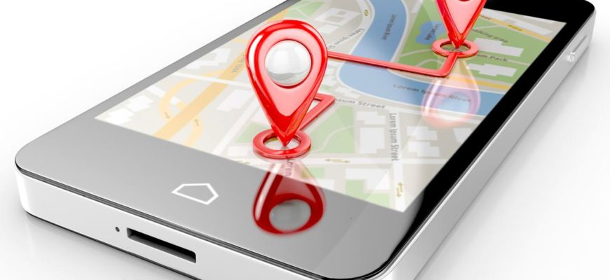
SOFTWARE ENGINEERING Tracking a Lost person
By
SAGAR -2110030164
BEJUGAMA SAI KISHORE-2110030316
BADE ASHRITH-2110030329
BHARGAV PANIGRAHI-2110030342
Under the guidance of
DR.FAHAD

Slide 2

Problem statement and domain
Around 54,750 children would have been reported missing in the last one year in India and only about half of them would have been traced
As per data on missing persons in Crime in India, a total of 2,90,439 people in year 2016, 3,05,267 people in 2017, and 3,47,524 people in 2018 have been reported as missing.

Slide 3

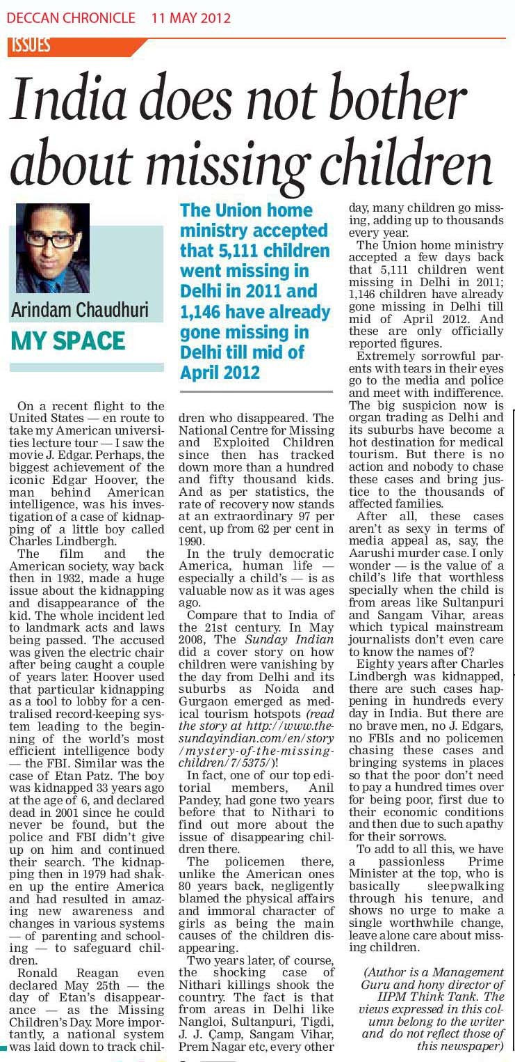
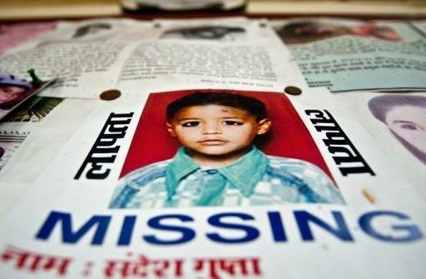
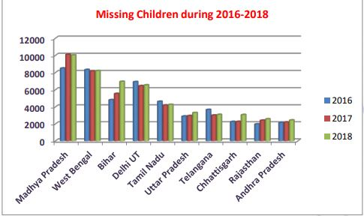
INTRODUCTION
On average, a child goes missing every 10 minutes in India, according to the women and child development ministry website for tracking missing children. At this rate, around 54,750 children would have been reported missing in the last one year in India and only about half of them would have been traced, if one goes by the police record on the missing children.

Slide 4

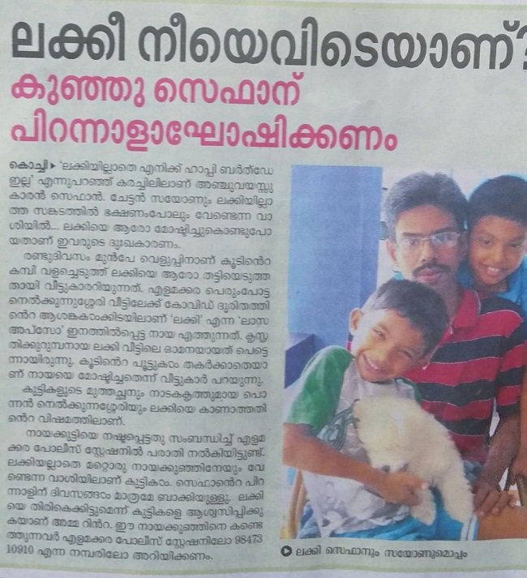
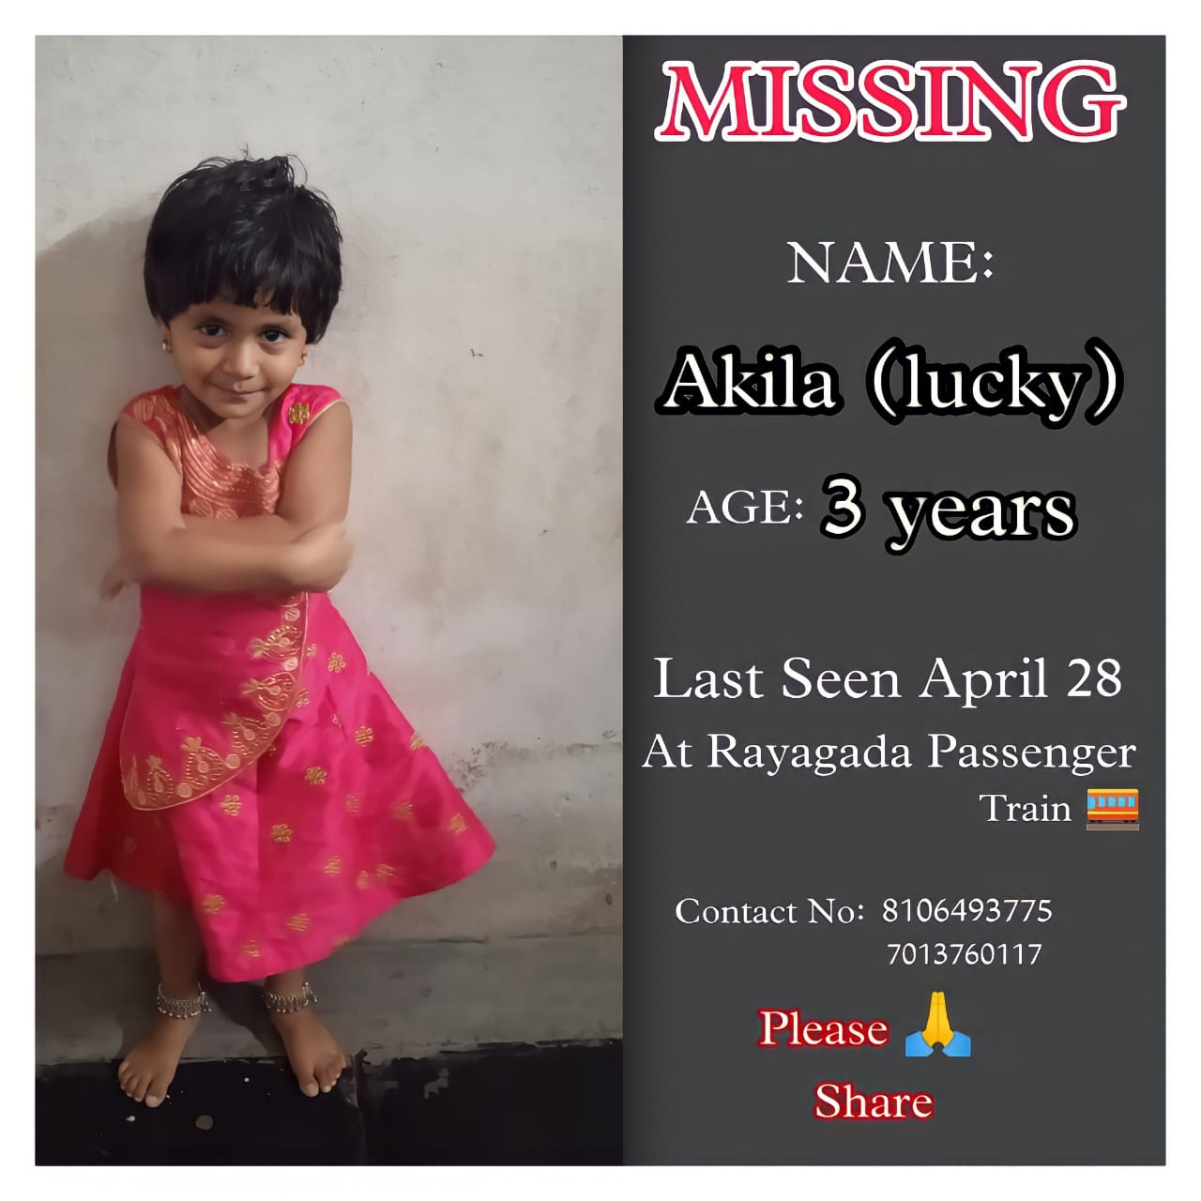
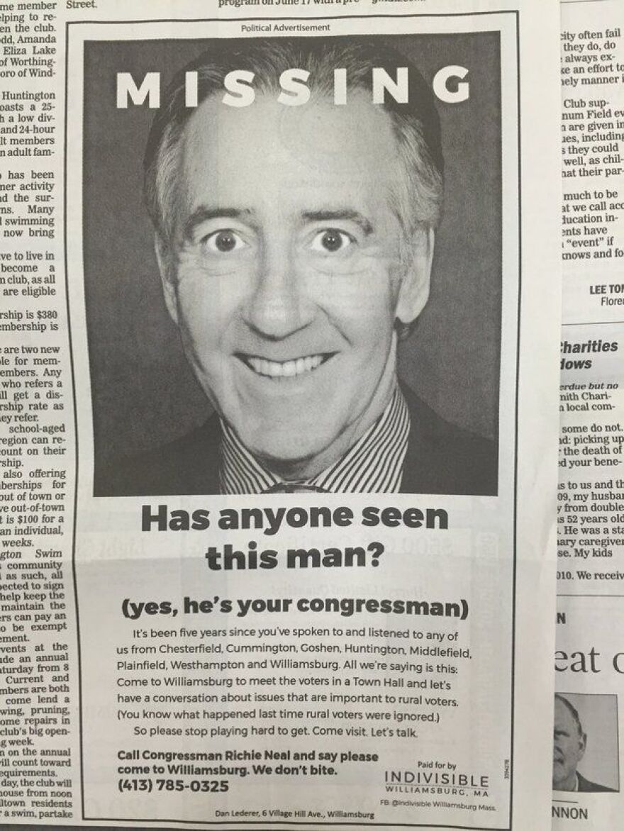
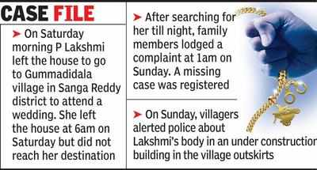
Problem Statement
Around 54,750 children would have been reported missing in the last one year in India and only about half of them would have been traced
As per data on missing persons in Crime in India, a total of 2,90,439 people in year 2016, 3,05,267 people in 2017, and 3,47,524 people in 2018 have been reported as missing.
Many pets go missing every year in India.
The crime data of the first quarter of this year has shown that 125 vehicles are being stolen every day.

Slide 5
Solutions
To solve this problem an app can be operated by any person by downloading it and the report about a missing person can be filed by just a click on a mobile.
To streamline the process of matching the missing persons, with recovered persons, the app has been developed. The app also has a feature to enter details of the traced persons kept in orphanage homes.
The public can make use of the search feature by putting various filters according to age, sex, date of missing etc.
The app also uses facial recognition to trace missing children. It can be used by parents to report missing children and by vigilant residents to report any vulnerable children found on the streets.

Slide 6
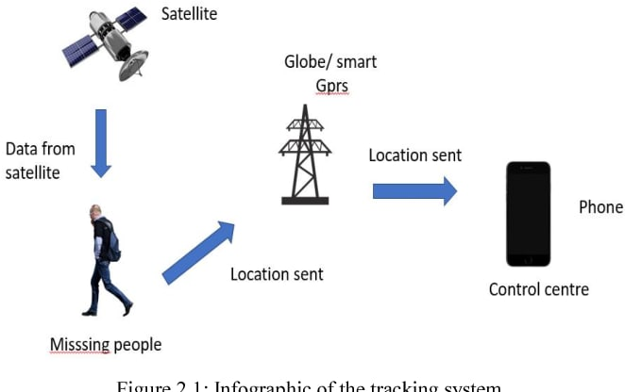
Proposed Algorithm Design Technique

Slide 7
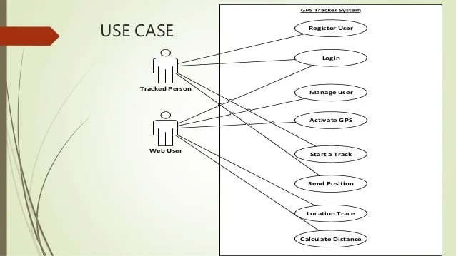
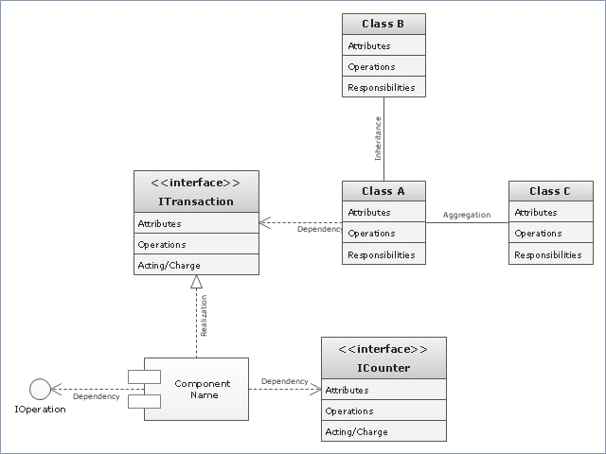
CLASS DIAGRAM

Slide 8
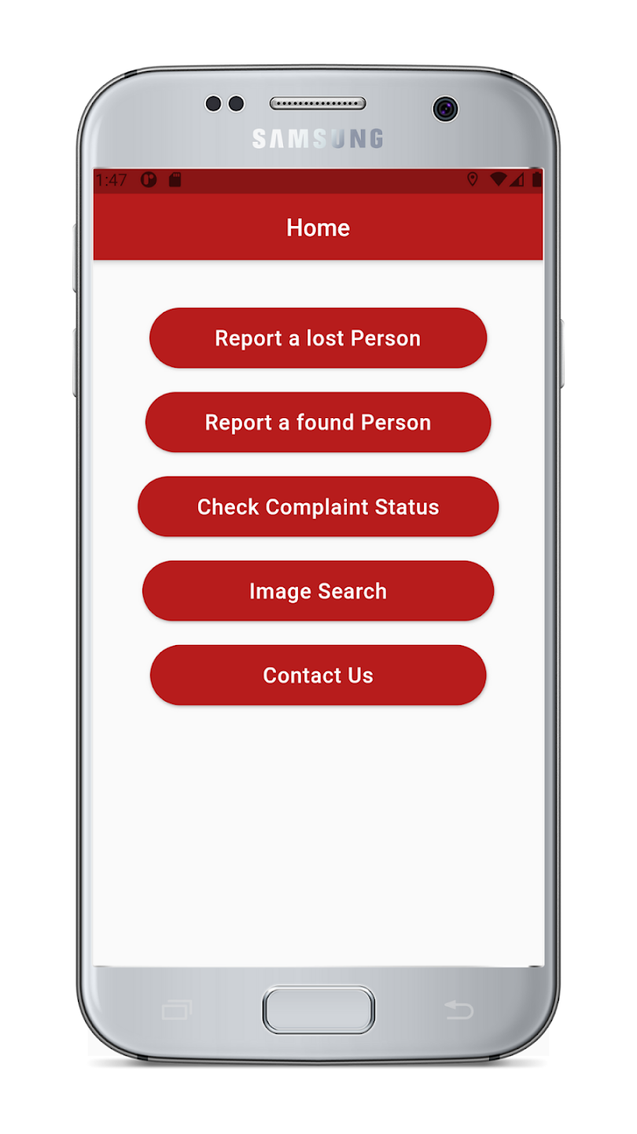
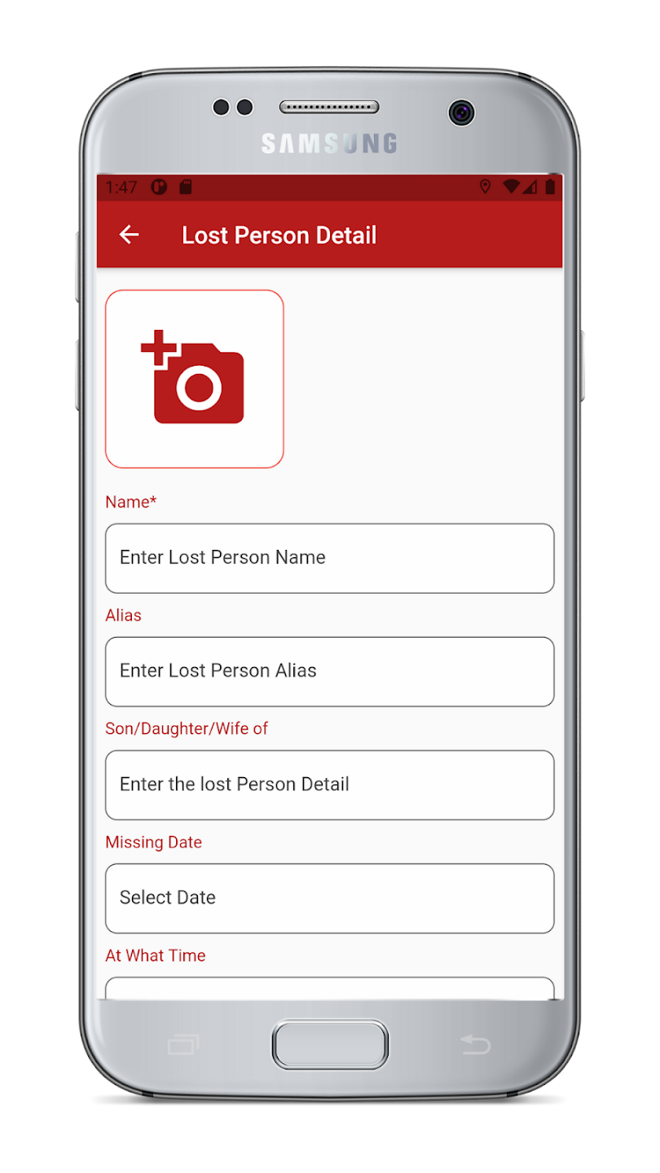
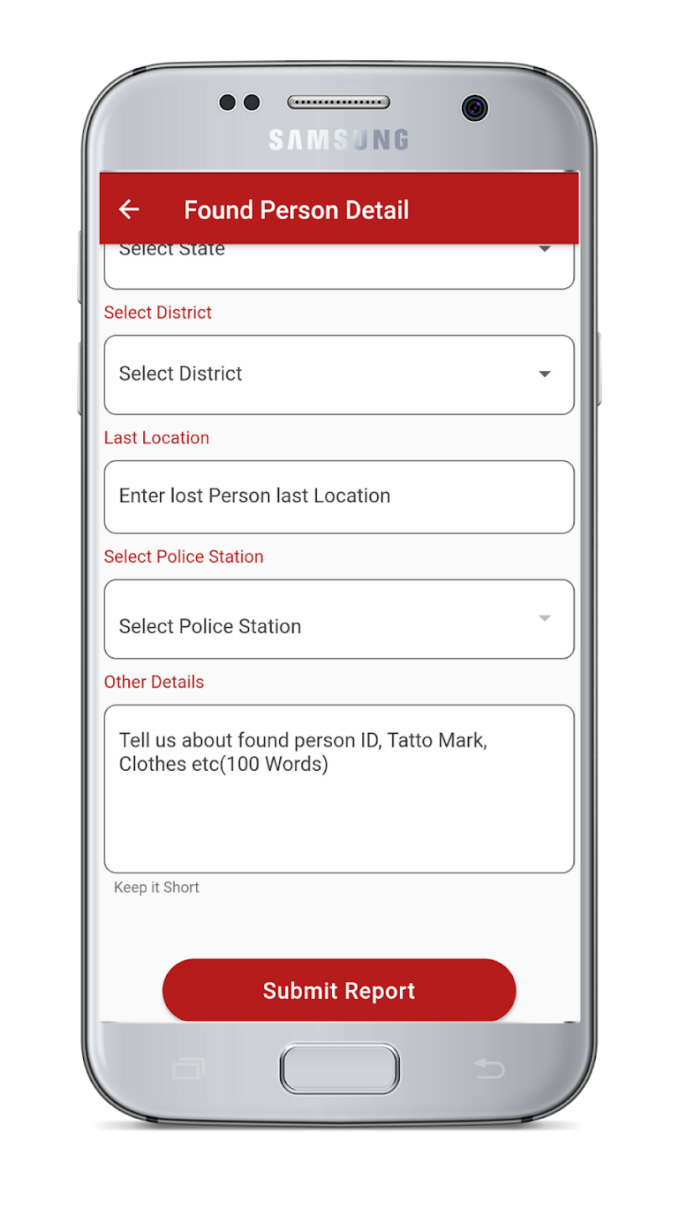
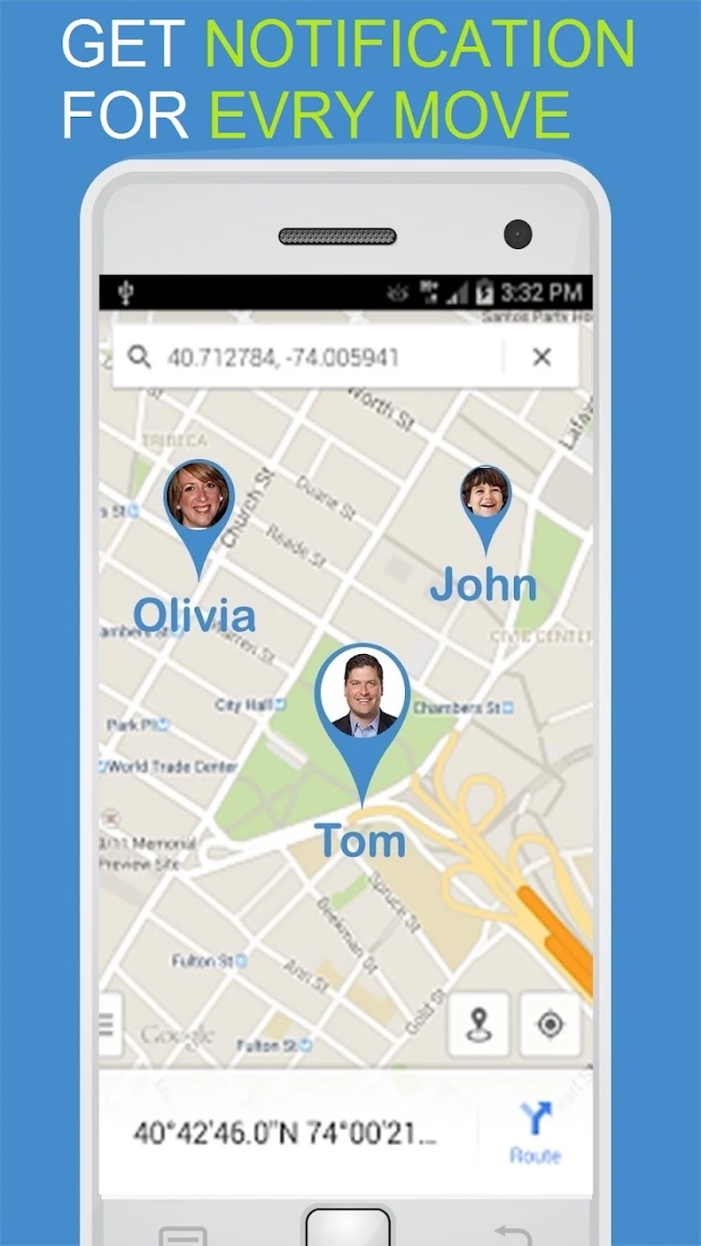
Sample application Images

Slide 9
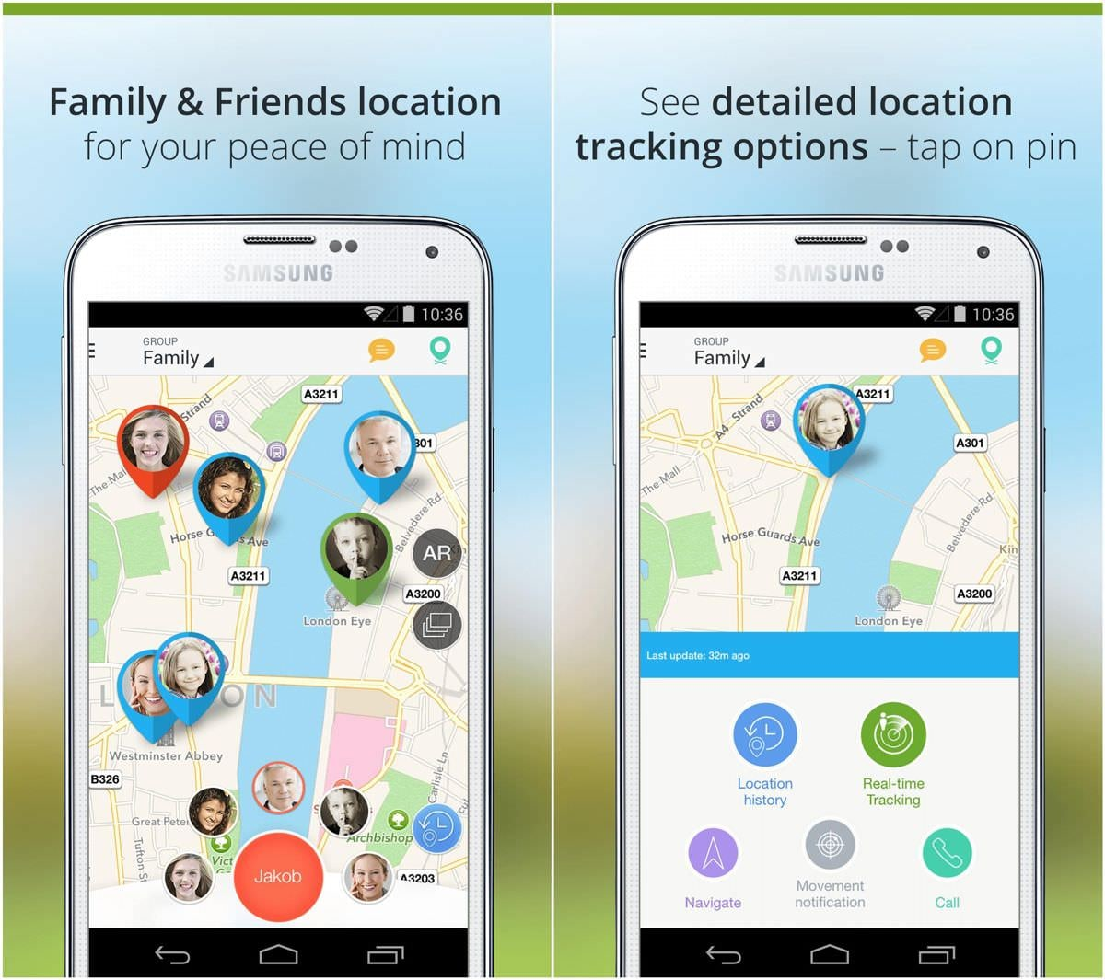

Slide 10


Data Structures needed
1. My SQL.
2. Terra ER.
3. UML

Slide 11
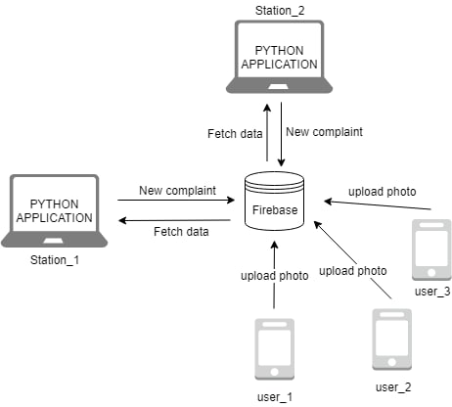
DESIGN MODEL

Slide 12
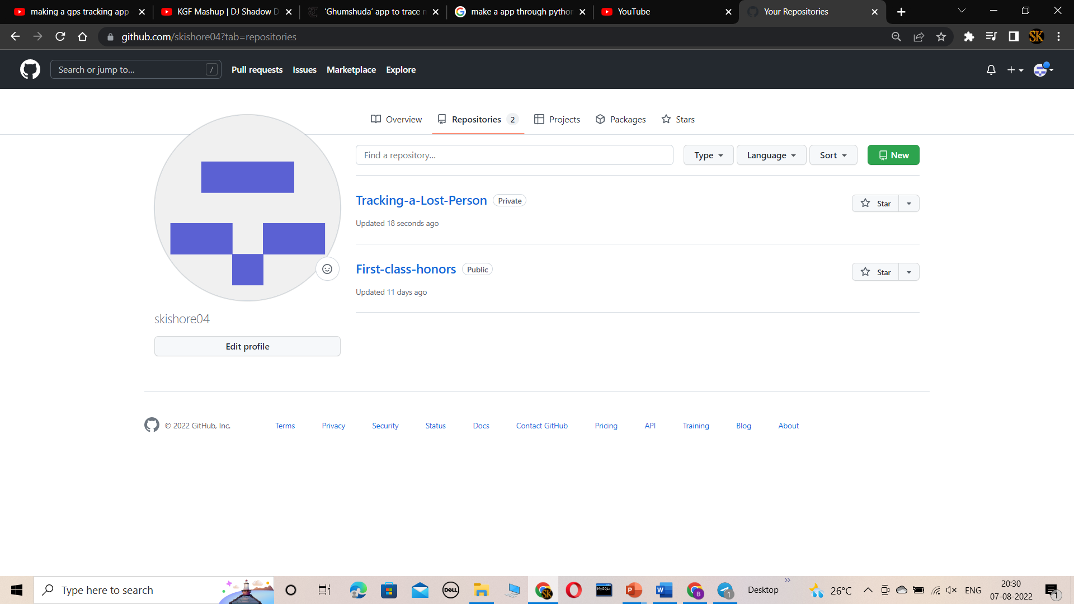
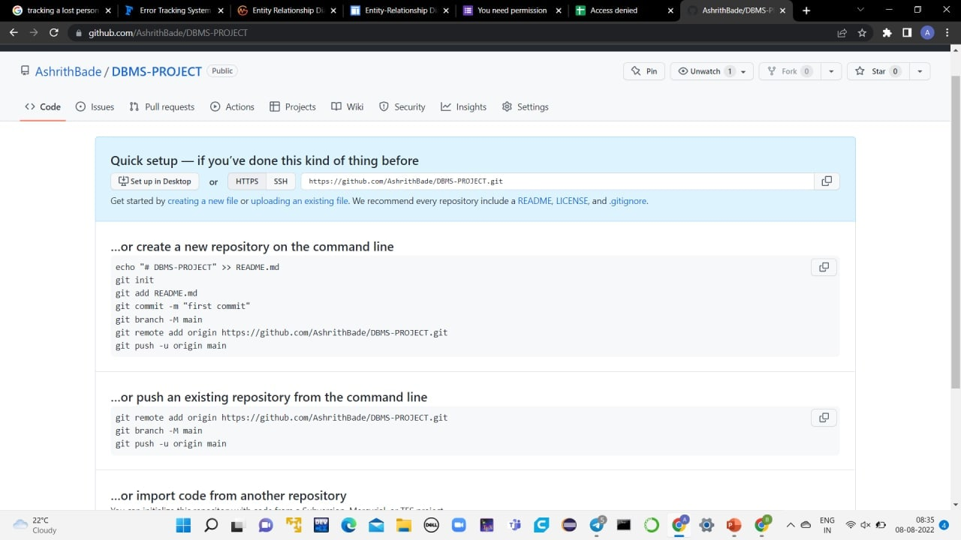
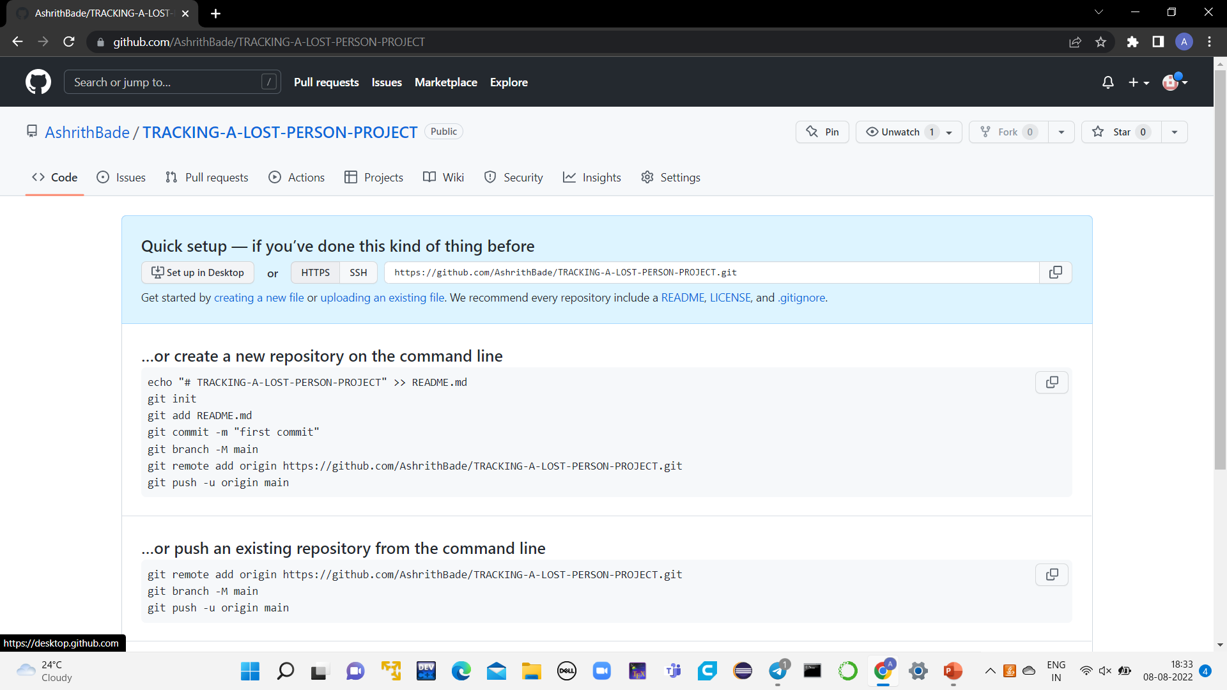
Github setup
For the Project tracking a lost person we are undergoing the process still the data base collection is going on still we just made the boot strap board and established a initial connections
https://github.com/skishore04/Tracking-a-Lost-Person.git
https://github.com/kashettisagar03
https://github.com/AshrithBade
https://github.com/Bhargav240

Slide 13
Division of work among the group members
Roll Number | Name | Work
2110030164 | Sagar | Front–end and Documentation
2110030316 | B.Sai Kishore | Front-end and Back-end
2110030329 | B.Ashrith | Front-end and Content Designer
2110030342 | P.Bhargavraj | Database connectivity

